Slide 1
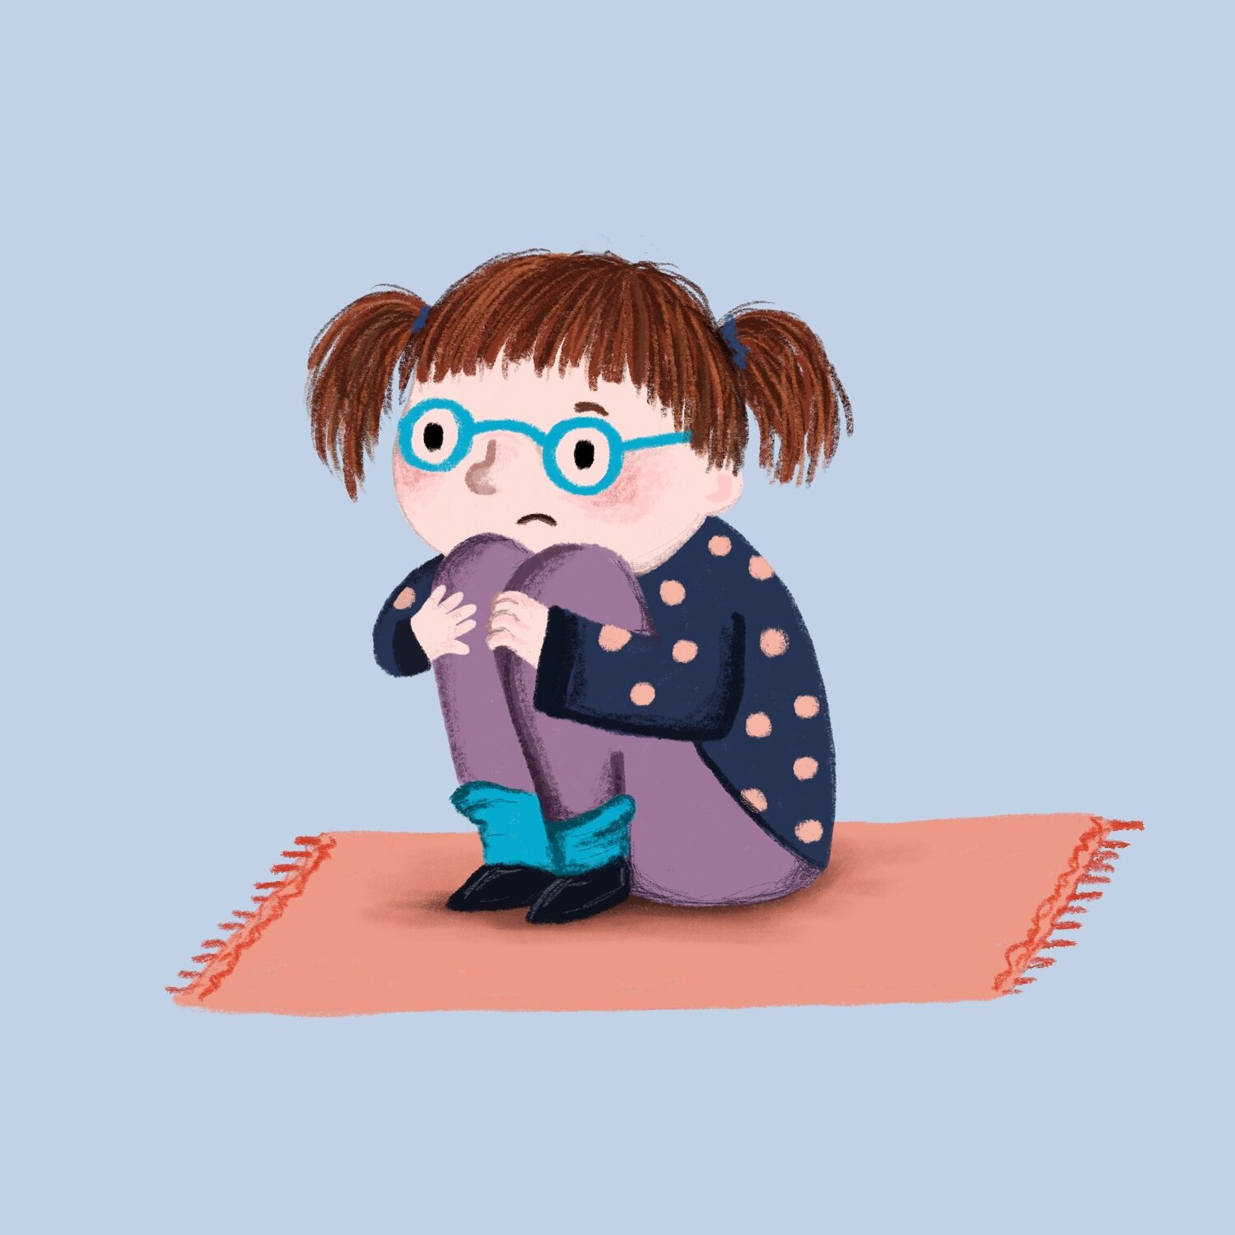
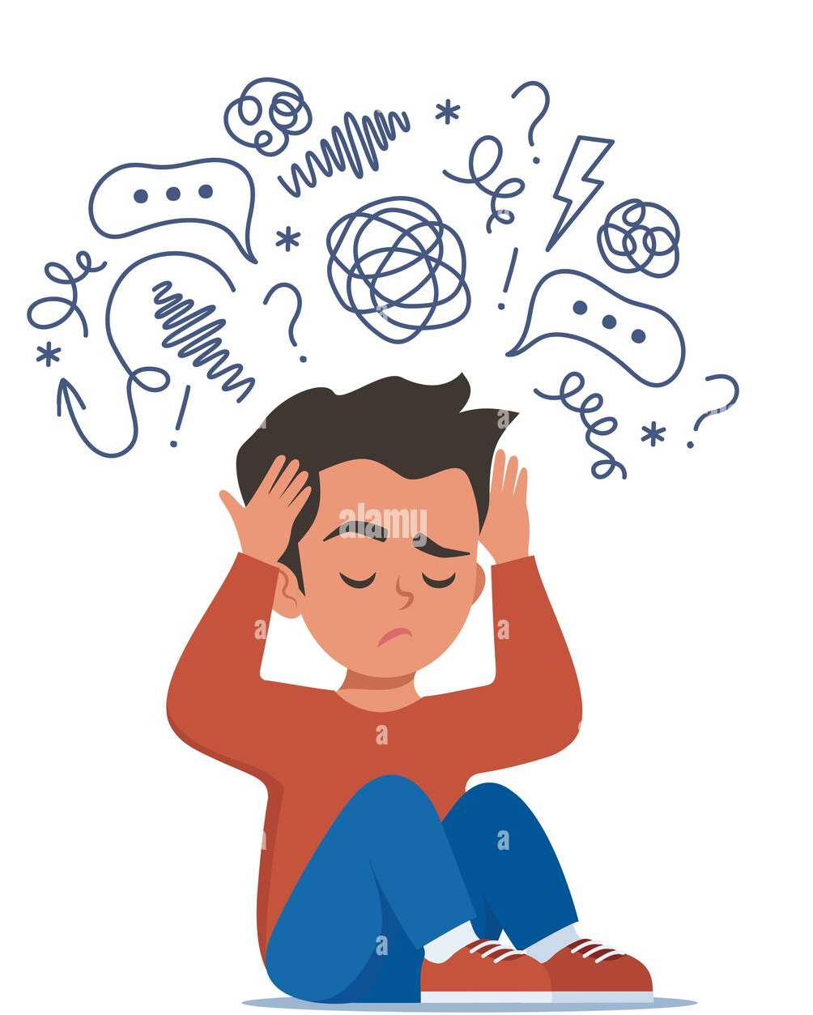
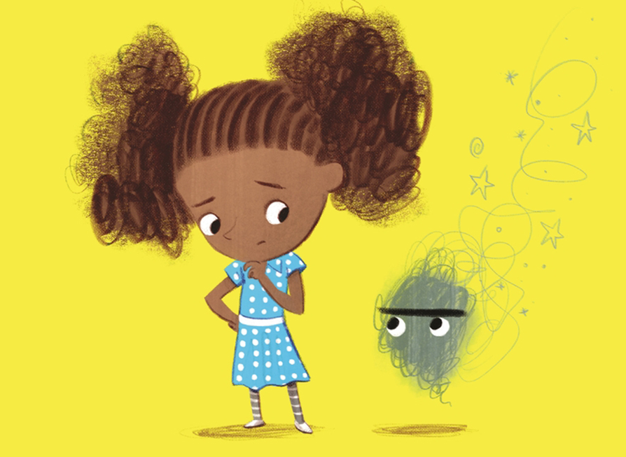
Parent Workshop :
Understanding Your Child’s Anxiety
3 Rivers Mental Health Support Team
Notes:
RJ

Slide 2



Ben Ansell – Education Mental Health Practitioner
Part of Three Rivers MHST
We sit within Hertfordshire Partnership Foundation NHS Trust (HPFT) under the umbrella of Child and Adolescent Mental Health Services (CAMHS) - but we’re a separate service to CAMHS.
We provide support for emerging and moderate mental health difficulties in children and young people by delivering evidence-based interventions.
I’m based at Eastbury Farm on Tuesdays
Notes:
RJ & KK

Slide 3
What is Anxiety?
Feelings of unease, worry or fear
Anxiety is one of the most common types of mental health difficulties
Anxiety is a normal emotion and can enhance our performance
Anxiety can become problematic when it is severe, frequent and interferes with everyday life
Anxiety is made up of different factors including genes, adverse life events, learning from other’s reactions and coping experiences
Notes:
KK
Anxiety can mean different things to different people!
We all experience anxious thoughts or feelings at some point in our lives.
What does the word ‘anxiety’ mean to you?

Slide 4
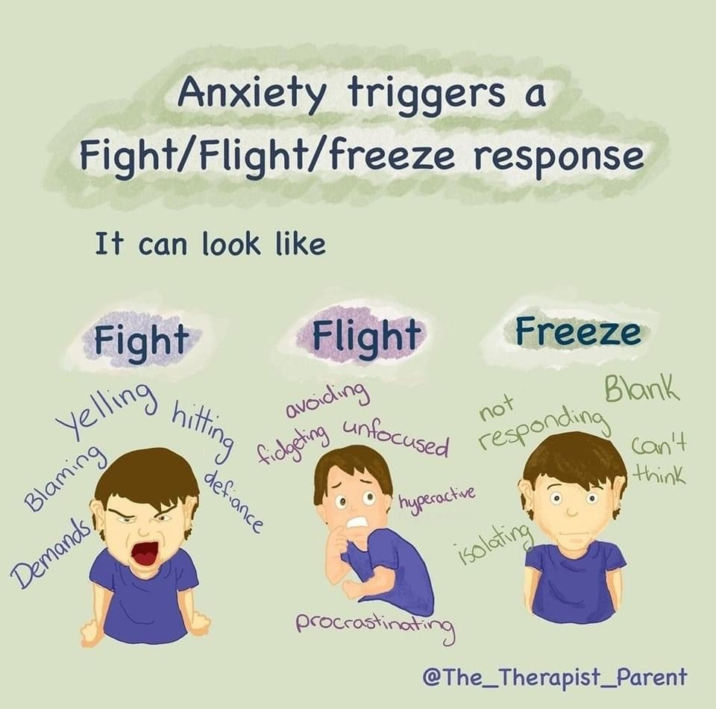
How does it present in your child?
Discus with person sitting next to you.

Slide 5
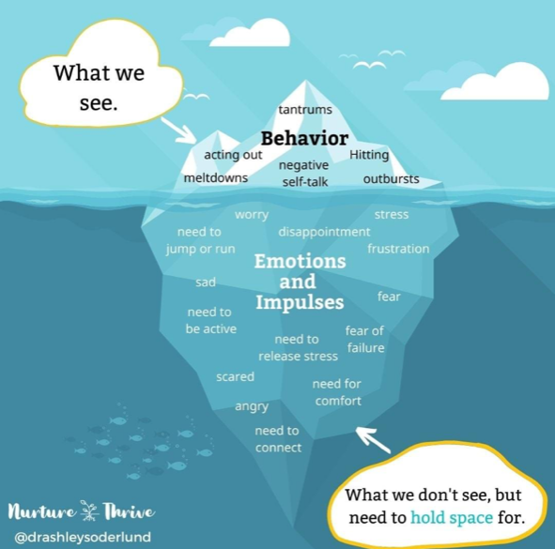
Iceberg Analogy
Notes:
RJ

Slide 6
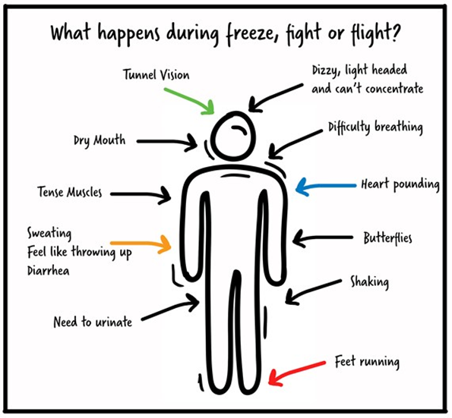
Bodily Sensations
Notes:
KK – very uncomfortable
As we have seen in the video – anxiety triggers a "survival mode" in our brains and bodies (sympathetic nervous system) and preparing us to fight, flight, freeze.

Slide 7
Understanding mental health...
Thoughts
Emotions
Behaviour
Bodily
sensations
Hot Cross Bun Model - a tool used to understand what is going on...
Notes:
KK
Mental health is about how our thoughts, emotions, physical sensations and behaviours interact and impact.
We follow an approach informed by cognitive behaviour therapy where we look at behaviour change and management of physical effects of anxiety.

Slide 8
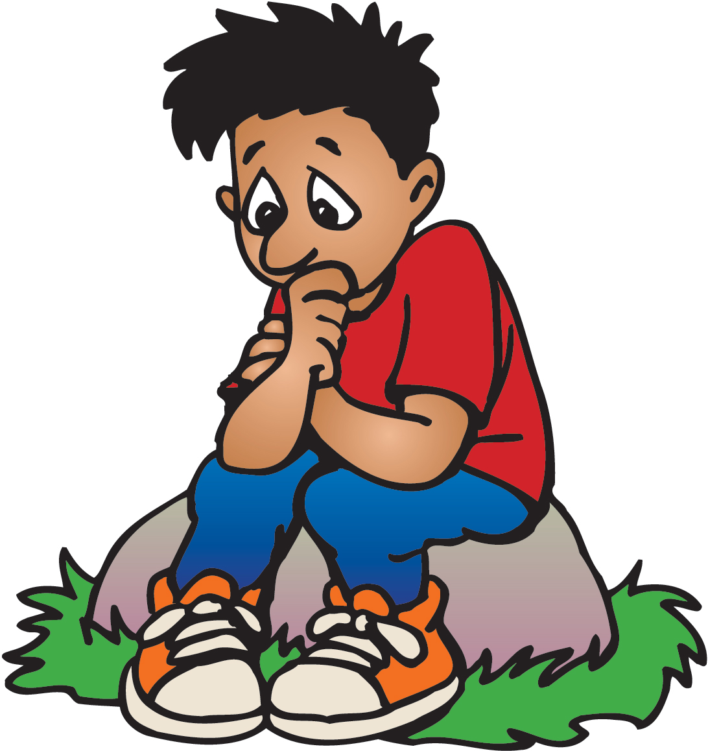
Case Example: Daniel (7 years old)
Physical sensations:
Tummy ache
Sweating
Headache
Increased heart rate
Thoughts:
What if something happens to mum when I am at school?
What if my friends don't like me?
I don’t want to go to the football game at the weekend, I want to stay at home.
Behaviours:
Going to the toilet a lot
Not putting hand up in class
Checking who is going to pick up from school
Playing alone at break
Tearful & fidgeting
Asking not to go
Emotions:
Sad
Scared
Worried
Notes:
KK & RJ

Slide 9

Think about your child when they are anxious, worried or scared:
What did they do? What was their behaviour?
What might have been happening in their body?
What thoughts were they having?
What emotions might they be feeling?
Take a few minutes to fill in the ‘hot-cross bun’ model
Notes:
RJ
Anxiety is one of the most common types of mental health difficulties
Anxiety is a normal emotion and can enhance our performance
Anxiety can become problematic when it is severe, frequent and interferes with everyday life
Anxiety is made up of different factors including genes, adverse life events, learning from other’s reactions and coping experiences (social learning theory)
5 mins

Slide 10
How to support your child with their fears and worries?
Asking curious questions to understand
Reduce reassurance giving and promote independence to boost confidence
Encourage your child to think of solutions and problem solve
Notes:
RJ

Slide 11



Try to understand your child’s anxious thoughts, what the triggers are, where they come from
Ask curious questions
What do you think is making you feel worried?
What do think will happen?
What is the worst thing that could happen?
Notes:
KK
Split into 6 groups (1 and 2 together) and brainstorm ideas for what each step could look like
5 mins plus feedback time
1. Be available to your pupils and show them you are open for a chat if they need one. Often easier when doing something but don't force the conversation.
2. Children learn from observation – promote a calm approach to show them that even though things are difficult, they are manageable.
3. Be accepting of their worry, anger and sadness about how things are at present. Try to avoid early reassurance which can often sound like “everything’s fine”. Recognise that these kinds of feelings are common and understandable. Explain that, although the physical feelings we experience in our bodies when we are anxious can be unpleasant, they are normal.
4. A worry is a thought, not necessarily a fact. Exploring alternative ways of looking at things might help to put worries into perspective and in turn result in less anxiety-provoking conclusions.
5. Empathise the importance of self-care. Help the child explore and understand their anxiety triggers.
6. Focus on emphasising confidence in the young person’s ability to cope and engage them in helping to think about different strategies.

Slide 12
How to respond:
Empathise- ‘That sounds really scary, it must be difficult for you..'
Normalise- ‘Lots of people would worry about that…’
Make suggestions…. ‘I wonder if you might be worried that….’
Check your understanding….repeat back what you have heard
Label emotions…. ‘So you feel nervous that…’
Notes:
KK
Booklet to be shared after the session

Slide 13
Removing reassurance:
Reassurance from the parent can help to maintain anxiety. Instinctively, we want to reassure our children, but it can prevent children from learning that they can cope on their own.
‘You’ll be fine’
‘Don’t be silly! There’s nothing to be scared of’
‘If you don’t want to go, just stay home’
Notes:
KK
Booklet to be shared after the session

Slide 14
Problem Solving
Problem solving will help an anxious child feel more confident to overcome any problems they encounter
What is the problem? | List solutions (Be creative!) | Rate each solution /10 | What is the best solution?
I forgot my homework and I’m scared I may get in trouble | Don’t go to school Tell the teacher my dog ate my homework Tell the teacher the truth and you’ll bring it tomorrow | 1 2 7 | Probably this one!
Notes:
RJ
The goal isn’t to eliminate anxiety, but to help a child manage it.
Don’t avoid things just because they make a child anxious.
Express and encourage positive — but realistic — expectations.
Take small steps to work towards goals

Slide 15
Promoting Independence
Encourage your child to have a go at new things!
Think of age- appropriate activities they could do independently, such as feed the pets, water the plants or make a sandwich
Give them lots of praise and encouragement, even for having a try!
Think of rewards that you could give them- such as choosing a family movie or a takeaway
‘
Notes:
KK
Booklet to be shared after the session

Slide 16
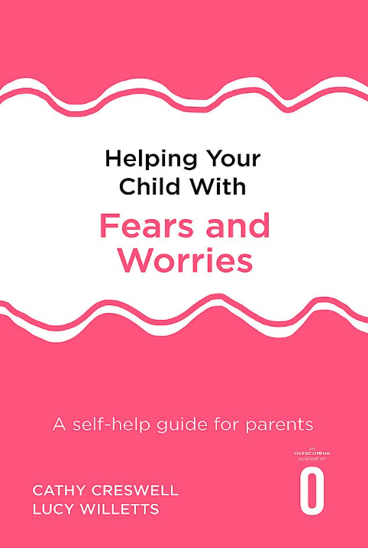




Signposting & Recommended reading
Anna Freud website https://www.annafreud.org/
Young Minds https://www.youngminds.org.uk/
NHS 5 steps to well-being https://www.nhs.uk/conditions/stress-anxiety-depression/improve-mental-wellbeing/
Notes:
Leave staff with this image to represent looking after our own wellbeing before we can look after children’s mental health. If we are not feeling ourselves, and looking after ourselves first, then we will struggle to support cyp mental health

Slide 17


Any questions?
Notes:
https://www.surveymonkey.co.uk/r/V9T2KBZ

