Slide 2
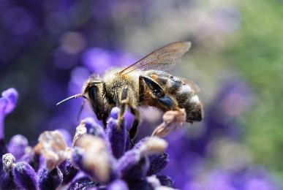
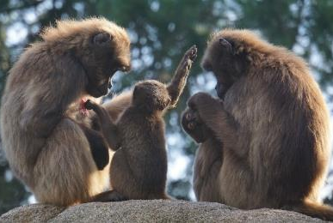
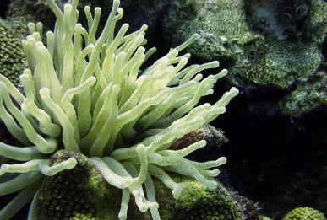
What Is Biodiversity?
There are over a million different known species in the world. There are many species of plants, fungi (including bacteria), insects, fish and animals (including mammals, birds and amphibians). Each species depends on another for survival. This careful balance ensures the stability of the different ecosystems, which all interlink.
The range of species within these ecosystems results in biodiversity. Biodiversity means the variety of life in a particular area. The more biodiversity there is, the healthier the ecosystem is.

Slide 3
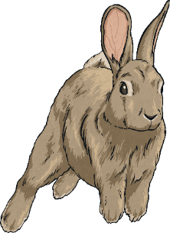
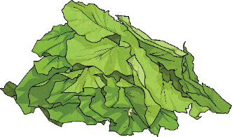
Why Do We Need Biodiversity?
Biodiversity is vital for living things to survive. Imagine there was only one species of potato. What would happen if that species of potato got a disease, resulting in the whole species dying out? There would be no potatoes left anywhere in the world. This would mean no chips, no crisps, no mashed or jacket potatoes.
Similarly, what if a species of plant was the main food for an animal, such as an elephant? If the plant died out, elephants would suffer and die out too.
Fortunately, the world is full of many different species of plants and animals. This means that thousands of different living things survive but they all rely on one another.
Look at this food chain:
If the food that rabbits eat was no longer available and their numbers decreased, foxes too would struggle to find enough food and this could risk their numbers falling dangerously low.

Slide 4
Ecosystems
An ecosystem is an environment where a group of living things interact with one another. There are many different types of ecosystems, ranging from rock pools, to ponds and woodlands.
Biodiversity results in healthy ecosystems, which are vital for the world. Humans depend on ecosystems working efficiently and consistently.
A healthy ecosystem:
Purifies water, making it safe to drink;
Removes harmful carbon from the air which plants use to release oxygen back into the atmosphere. This is vital for animals, including humans, to survive;
Helps areas to recover more quickly when they have been destroyed by extreme weather or fires.
Think about what would happen without biodiversity.

Slide 5
Facts and Figures
The global loss of biodiversity effects the earth in significant ways. The United Nations reports that:
Since 1900, populations of 237,000 mammals and birds have become extinct;
More than 400 species of vertebrates have become extinct in the last 100 years alone. This includes animals, such as the golden toad and the ivory billed woodpecker;
Around 500 animal species are on the brink of extinction. The list includes the Sumatran rhino, the Espanola Giant Tortoise and the Harlequin frog;
Over the next few decades, more than a million species of plants and animals are likely to become extinct; this is the fastest rate ever known.
But why does it matter?
Talk About It
    Talk to the person near you about whether it matters that numbers of animals and birds are declining and give your reasons.

Slide 6
Why Is Biodiversity Declining?
Increasing Carbon Levels
High levels of carbon dioxide are being released into the atmosphere through the burning of fossil fuels. This greenhouse gas builds up in the atmosphere, trapping in the heat from the sun, which warms up the earth. This is resulting in melting ice caps and changes in weather patterns, creating more floods, wildfires and more extreme weather. This destroys habitats.
Use of Land and Sea
Vast areas of land are being cleared at an alarming rate for agriculture, palm oil production, logging and mining. Humans are also exploiting the world's oceans by overfishing, causing the number of fish to decline.

Slide 7
Why Is Biodiversity Declining?
The population of humans on the planet is now over 7 billion. A lot of plants and animals are needed to feed so many people. Animals are also hunted to the brink of extinction for entertainment, as well as for the use of their body parts, which often become decorations.
Exploitation of Animals
Climate Change
The high levels of carbon dioxide in the atmosphere is resulting in a warmer earth, which is causing changes in the global climate. This is affecting all living things, as many cannot adapt quickly enough to cope with these changes.

Slide 8
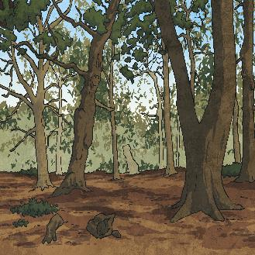
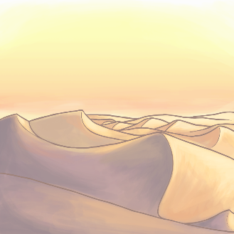
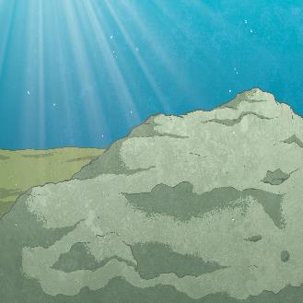
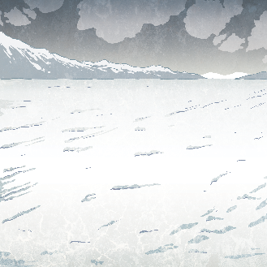
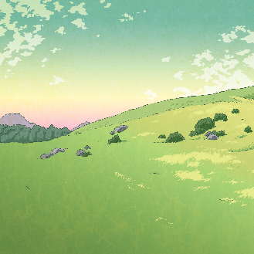
Types of Habitat
Here are the main types of habitat, all of which are under threat.
forests
deserts
aquatic
regions
  polar
  regions
grasslands

Slide 9
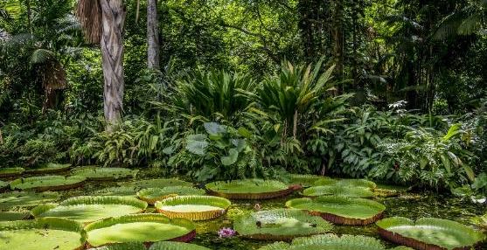
Find out what effect palm oil production is having on biodiversity.
Find Out
Forests
Forest habitats include rainforests, jungles and woodlands. The Amazon rainforest is the largest and most well-known rainforest habitat in the world. It is located in South America, forming part of nine different countries and includes a river, which is almost 7,000 km long; that is about the same distance from London to New Delhi by plane!
It provides a habitat for:
40,000 plant species;
1300 bird species;
3000 types of fish ;
430 different species of mammal;
Between 400 - 500 Indigenous tribes.
Forests are vital, as they absorb greenhouse gases from the atmosphere. This makes the earth’s air safer for all living things. The Amazon is often referred to as the ‘lungs of the earth’, as the thousands of plants that grow there remove harmful carbon dioxide from the air, replacing it with oxygen, which living things need to survive. However, vast areas of the Amazon are being removed, in a process called deforestation, to make way for mining, palm oil production, growing animal feed and logging.

Slide 10
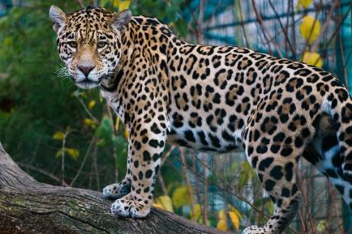
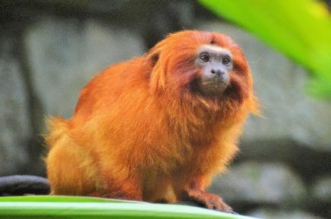
Forest Animals
The Amazonian jaguar is under threat from the loss of its habitat and the illegal wildlife trade. They are hunted for their skins and for use in ancient medicines. It is believed that there are fewer than 170,000 remaining and they are classed as endangered. They are top predators and are important for keeping the balance in food chains.
The golden lion tamarin lives in trees and is an omnivore, eating fruit, vegetables, small lizards, snails and spiders. This makes them important animals for controlling insect numbers. Due to them being captured to be sold as pets, and the loss of their habitat, there are fewer than 1500 golden lion tamarins left in the wild.

Slide 11
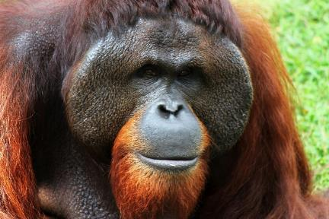
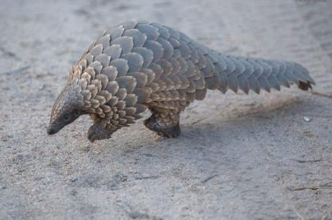
Forest Animals
The Bornean orangutan lives in lowland rainforests, as well as swamp, tropical and mountainous forests. Their numbers have dropped by more than half in the last 60 years. They usually only have one baby at a time so their numbers do not increase very quickly. Their habitats have also been reduced by 55% in the last 20 years. Orangutans eat over 500 species of plant which means they play a vital role in seed dispersal, which helps keep forests healthy. These animals are now critically endangered.
Some species of pangolin have become critically endangered, mainly due to them being illegally captured for their scales. These are used in medicines in some countries. In 2019 alone, it was estimated that 195,000 pangolins were captured and sold for their scales. However, since June 2020, pangolins have become more protected as the Chinese government have made it illegal to use their scales in medicines.
“pangolin” by Adam Tusk is licensed under CC BY 2.0

Slide 12
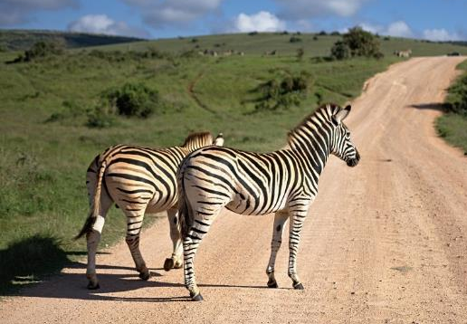
Grasslands
Grasslands are known by other names, such as prairies, savannahs, velds and rangelands. Grasslands can support large numbers of animals that graze, like zebras, bison and antelopes. However, vast areas of grasslands have been removed to make way for humans to plant crops, such as maize and corn. The purpose of this is to provide enough food for the large amount of people now living on the planet.
There is now less space and food for the number of animals that rely on the grasslands. This is changing the balance of the ecosystem, meaning fewer species will be able to survive.
Hunting animals, such as elephants and lions, has become more popular over the last few decades which has also led to a huge decline in animal numbers.
Find Out
    Which grassland animal is most at risk from extinction and why?

Slide 13
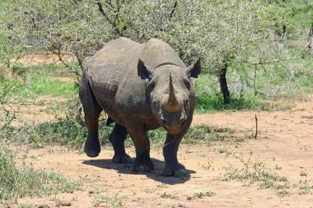
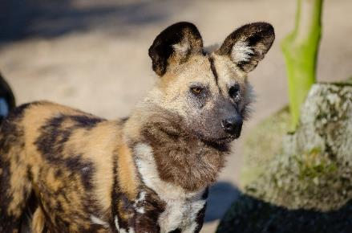
Grassland Animals
The black rhinoceros is now critically endangered due to being hunted to the brink of extinction in the 20th century. Between 1960 and 1995, numbers dropped by 98%, leaving fewer than 2500 globally.
There have been huge efforts made towards conserving these animals and their numbers are now believed to be around 5600. Although still critically endangered, the future looks better for the black rhino.
The African wild dog is classed as endangered, with fewer than 5000 left in the wild. They are social animals, known to hunt in packs ranging between ten and 40 animals. Their numbers are declining for a number of reasons, including the loss of their habitat to crop plantations. They are important for removing sick or weak animals and for keeping a steady balance of certain species, like warthogs and antelopes.

Slide 14
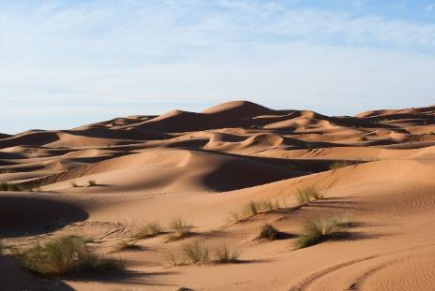
Deserts
Deserts are defined by how much (or how little) rainfall they have, with most having less than 25cm of rain in a year. Although very hot during the day, they can be very cold at night, meaning that plants and animals that live there have had to adapt to such a harsh habitat. The driest desert in the world is the Atacama Desert in Chile which, in some areas, only gets an average of 1mm of rain a year!
Plants, like cacti, are able to store water in their stems and survive for a long time without rain. Animals, many of which only come out during the cooler nights, find water in the food they eat.
The animals that live in deserts have evolved to suit the harsh environment. However, as the climate changes as a result of human activity, the temperatures of deserts are rising faster than these animals can evolve.
Find Out
    Can you identify a food chain in a desert habitat?

Slide 15
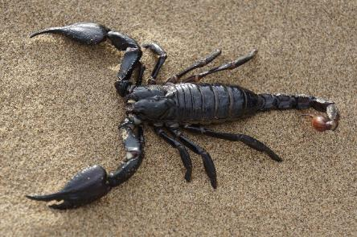
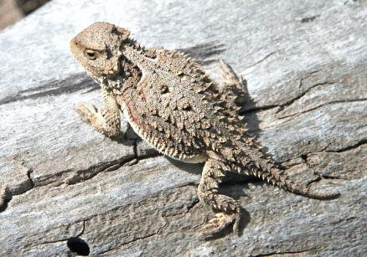
Desert Animals
There are around 2000 species of scorpion in the world. They mainly eat insects, making them important for maintaining balance in ecosystems. These invertebrates can survive in extreme environments, having been around for millions of years. They can slow down all their bodily functions to save energy but can quickly spring to life when they need to hunt again.
Horned lizards are reptiles with bodies that are similar to that of a toad. They have small spines on their backs and heads, which they can use to scare away predators. As they feed on a diet of insects, they are also important for controlling insect numbers.

Slide 16
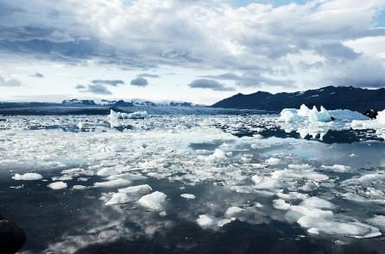
The Polar Regions
The polar regions include the Arctic, which is at the north of earth, and the Antarctic, which is at the south. Millions of people inhabit the Arctic but no one lives permanently in the Antarctic. In both regions, the environment is very harsh so animals and plants have evolved to cope with such extreme cold.
The Arctic region is home to much biodiversity but the area is suffering due to climate change. Things that happen hundreds of miles away are affecting the freezing of the ice caps and they are melting more and more each year. This is resulting in more extreme weather and flooding.
Pollution is also causing major problems. Debris is finding its way to the Arctic which animals either get tangled in or swallow, causing deaths in huge numbers. Toxins from ships, cruise liners and fishing boats are polluting the water which in turn, affects food chains, ultimately killing polar bears.
Find Out
Find out how climate change is affecting people who live in the Arctic.

Slide 17
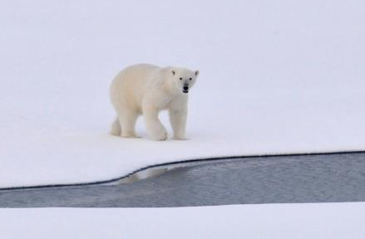
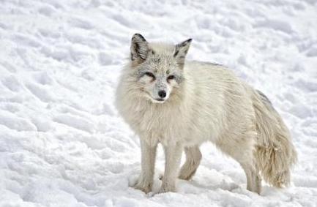
Arctic Animals
The polar bear is the Arctic’s top predator, mainly feeding on seals. It depends on the ice to travel across vast areas, to hunt for food and for a place to build a den, deep in the snow. They are vulnerable animals because their habitat is declining and is literally melting away due to climate change.
The Arctic fox feeds on lemmings, small birds and fish. In the past, these mammals have gone through difficult times as they have been hunted for their fur. Although they are no longer threatened, climate change is impacting their habitat and they often struggle to find their prey.

Slide 18
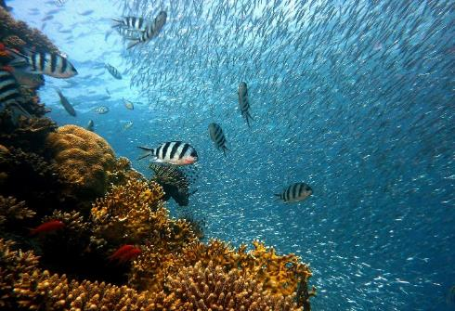
Aquatic Regions
Oceans are vital for the health and biodiversity of earth. Covering more than 70% of the planet, oceans support a vast number of marine species, which sustain the life of all living things on land, including humans. Oceans are responsible for producing half the oxygen we use to breathe as well as being a major part of the water cycle, which is essential for life.
All oceans, seas, rivers and lakes are being polluted at an alarming rate as a direct result of human activity. Rubbish, such as plastic, is entering the oceans and poisoning hundreds of species of plants and animals. As well as strangling them, it is also changing their ability to reproduce.
Many areas of the ocean are being overfished, mainly to sustain the demand from humans. Many creatures are accidentally caught in fishing nets, such as dolphins, turtles, sea birds and sharks, threatening their existence.
Find Out
  How would a loss of marine biodiversity affect the planet?

Slide 19
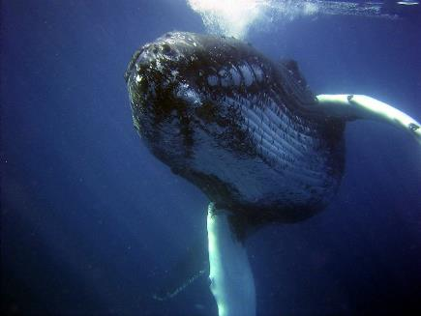
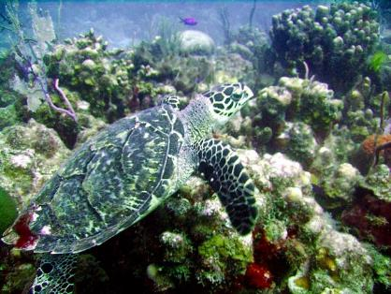
Aquatic Animals
Whales are often seen in the Arctic region. They breathe air and are warm blooded mammals, giving birth to live young. Many species are classed as vulnerable or endangered due to the effects of overfishing, shipping, pollution and due to the loss of their habitats.
Hawksbill turtles live among coral reefs, feeding on sponges that live there. Coral reefs are declining rapidly, due to pollution and climate change, which is having a significant impact on the number of hawksbill turtles. These animals are vital for keeping the biodiversity of coral reefs healthy. Often hunted for their beautiful shells to be made into ornaments and jewellery, as well as getting tangled in sea pollution, the hawksbill turtle is now critically endangered.

Slide 20
Think About It
If there were no animals in the world, what would it be like?
If there were no plants, including trees, what would it be like?
Can humans survive without plants or animals?
Biodiversity is declining as a direct result of human activity.
Why does biodiversity matter?
What can you do about it?
Find out what you can do to help.

Slide 21

Glossary
biodiversity - Biodiversity means all the plants and animals in the world or in a particular habitat.
carbon dioxide - A gas made up of carbon and oxygen which is present in the earth’s atmosphere.
deforestation - The action of deliberately clearing a large area of trees.
ecosystem - An area of living and non-living things, such as insects, birds and animals, as well as water, rocks and sand.
endangered - Refers to an animal or plant that is in danger of disappearing altogether because there are so few of them left.
habitat - The natural home for a plant or animal where there is food and shelter.
species - The way a living thing is classified according to scientists, based on a range of criteria.

