Slide 1


Year 1 Phonics Meeting
Friday 9th October 2026
Mrs Rowlinson

Slide 2
Purpose
What is Read Write Inc. Phonics?
Your child’s journey so far
What next? Year 1 and 2
How your child learns in school
Support at home
Phonics Screening

Slide 3
What is phonics?
Phonics - the sounds in our language
Phoneme - a sound –’a’
Diagraph/Trigrpah - two or more letters that make a sound – ‘ay’
Grapheme - the letter or letters that represent a sound
Blending - pulling together individual sounds, groups of sounds or syllables for reading

Slide 4
Read Write Inc. Phonics
Reading and spelling programme
Fred talk
Fred in your head
Digraph (th, ng, ay) or ‘Special Friends’
Trigraph (igh) or ‘Special Friends’
Alien/nonsense words (thid)

Slide 5
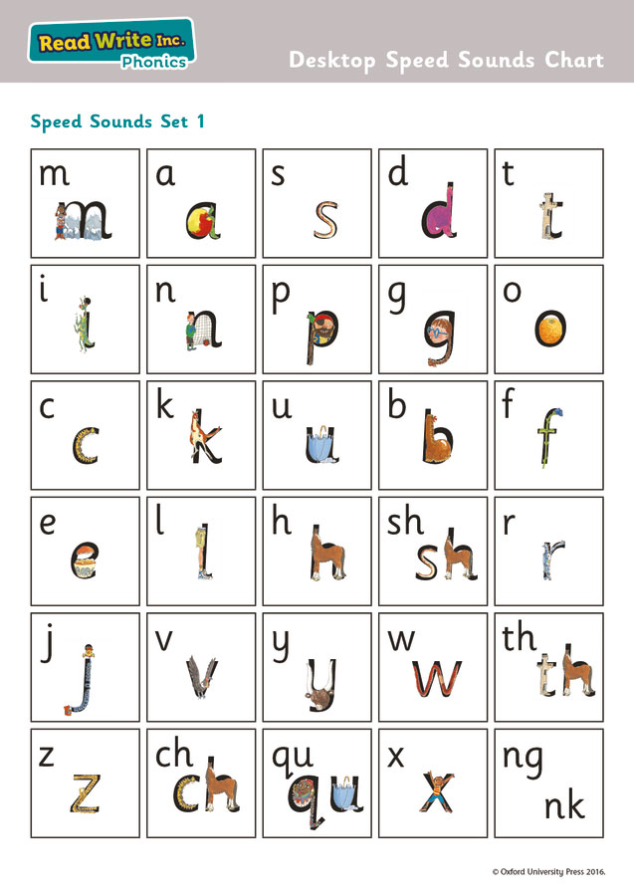
Your child's journey so far
Teaching of Set 1 sounds
and letter formation

Slide 6
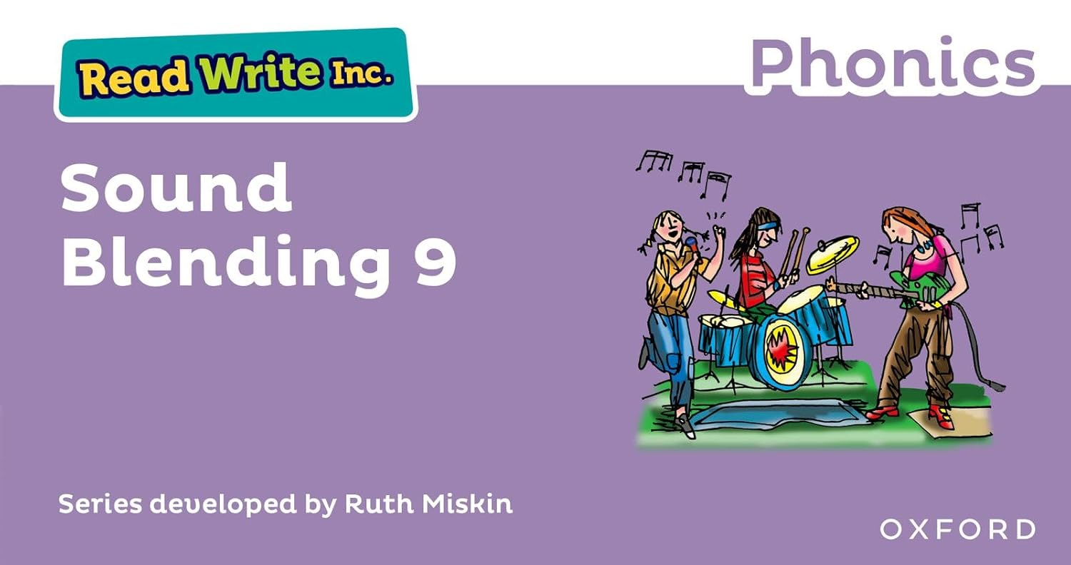
Your child's journey so far
Oral blending, learning to blend, reading and spelling words
c-a-t

Slide 7
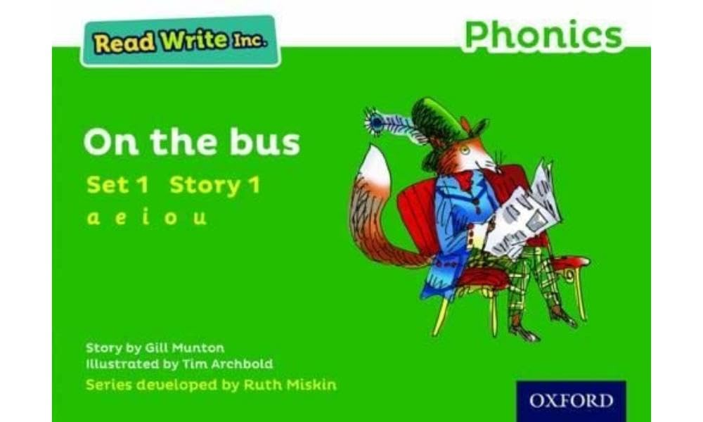

Your child's journey so far
Reading and understanding sentences - storybooks

Slide 8
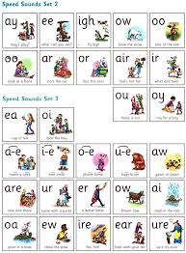
What next? Year 1 and 2
Learning set 2 and 3
sounds and spelling
words
Learning in action!

Slide 9
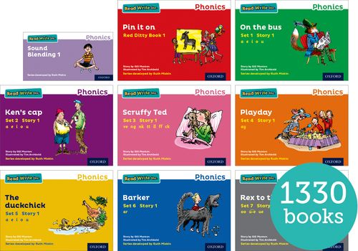
What next? Year 1 and 2
Continuing to read storybooks with increasing fluency expression and understanding

Slide 10
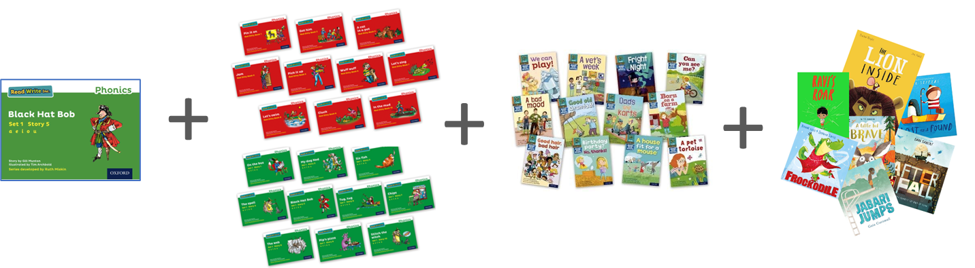
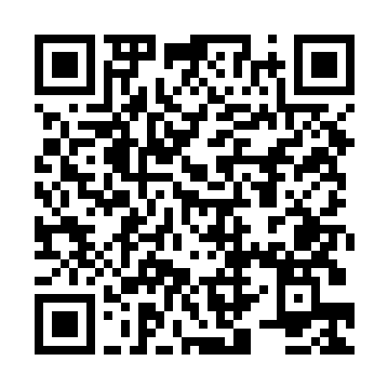
Support at home
https://schools.ruthmiskin.com/resources/vc-pathways/525744/hJmY4kD9PL46P68S
Little and often
Repeat reading for fluency and understanding
Discussion and questions
Reading for pleasure
Listening to stories
Phonics videos

Slide 11
Phonics Screening
The Year 1 screening test was introduced in 2012 and every school must carry out the same test in the same way and in the same week
The test will take place during the week beginning 14th June 2027 – please make sure that your children are in school
Since 2012 the children need to correctly READ 32 of the 40 phonetically decodable words to pass. Last year the pass mark dropped to 31.
The words are a mixture of real and ‘alien’ words which test their decoding skills
All words are based on Set 1, 2 and 3 sounds and some additional sounds
Includes some words with two syllables (e.g. chapter, boiling)
Children who do not meet the expected standard re-sit it at the end of Year 2
The test is carried out 1:1 in a quiet place and takes between 5 and 15 minutes

Slide 12
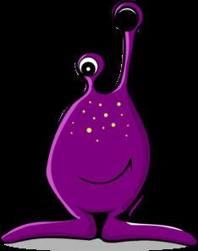
What are ‘alien words’?
Taught from Reception
These assess whether the children are able to use phonic knowledge to identify diagraphs/special friends and decode and read an unknown word e.g.
kigh
baim
splaw
groiks

Slide 13
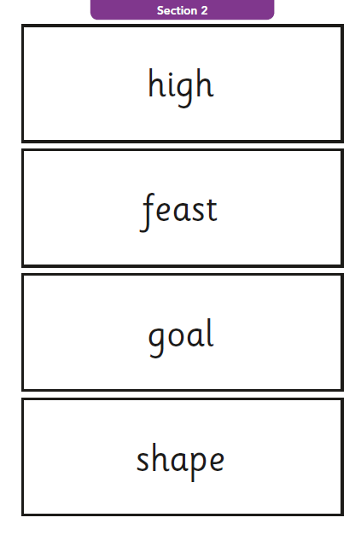
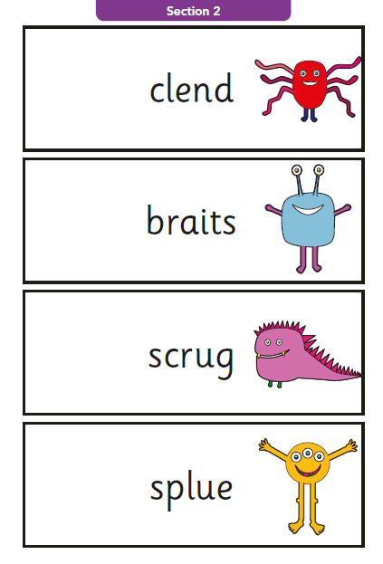
Example from 2017 paper

Slide 14
Supporting Resources
Set 1, 2 and 3 sounds – paper copy
Presentation - website
Sample paper link – via parent mail (later in the year)

Slide 15
Questions?

