Slide 1

Phonics Screening Check Meeting
Wednesday 12th October 2022
Mrs Rowlinson

Slide 2
What is phonics?
Read Write Inc. – our phonics programme
Phonics - the sounds in our language
Phoneme - a sound
Grapheme - the letter or letters that represent a sound
Blending - pulling together individual sounds, groups of sounds or syllables to read a word and then a sentence

Slide 3
Phonic terms in Read Write Inc phonics
Fred talk – sounding out
Fred in your head – sounding out in your head
Digraph (th, ng, ay) or ‘Special Friends’
Trigraph (igh) or ‘Special Friends’
Alien/nonsense words

Slide 4

What are ‘alien words’?
At Eastbury Farm, we cover alien words from the early stages of Reception when the children are secure in their Set 1 sounds
These test whether the children are able to use phonic skills to identify diagraphs/special friends and decode and read word e.g. mas
tam
fay
splee

Slide 5
PSC Sounds
Set 1
m a s d t i n p g o c k u b f e l h sh r j v y w th z ch qu x ng nk
Set 2
ay ee igh ow oo oo ar or air ir ou oy
Set 3
a-e ea i-e o-e u-e aw are ur er ow ai oa ew ire ear oi ure
Additional Sounds
ie ie au ph kn ue e-e

Slide 6
Rhymes for sounds
Set 3
ea – cup of tea
oi – spoil the boy
a-e – make a cake
i-e – nice smile
ow – brown cow
o-e – phone home
u-e – huge brute
aw – yawn at dawn
are – care and share
ur – nurse with a purse
er – a better letter
ai – snail in the rain
oa – goat in a boat
ew – chew the stew
ire – fire, fire
ear – hear with your ear
ure – sure it’s pure
Set 2 Sounds
ay – may I play
ee – what can you see
igh – fly high
ow – blow the snow
oo – poo at the zoo
oo – look at a book
ar – start the car
or – shut the door
air – that’s not fair
ir – whirl and twirl
ou – shout it out
oy – toy for a boy
Additional sounds
ie – tie in a pie
ie – shield in a field
au – santa claus in August
ue – blue glue
ce – making a ‘s’ sound
(pounce,
sauce)

Slide 7
Split sounds
a-e e-e i-e o-e u-e
shape theme like home tune
(
(
(
(
(

Slide 8
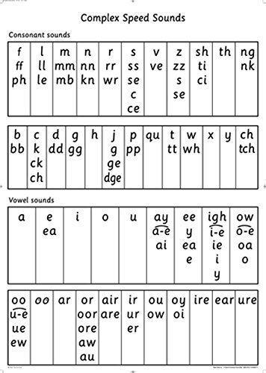
Speed sounds chart

Slide 9
Phonics Screening Check
The Year 1 test was introduced in 2012 and every school must carry out the same test in the same way and in the same week
The test will take place during the week beginning 12th June 2023 – please make sure that your children are in school
Since 2012 the children need to correctly READ 32 of the 40 phonetically decodable words to pass
The words are a mixture of real and ‘alien’ words which test their decoding skills
All words are based on Set 1, 2 and 3 sounds and some additional sounds
Includes some words with two syllables (e.g. chapter, person)
Children who do not pass the test will re-sit it at the end of Year 2
The test is carried out 1:1 in a quiet place and takes between 5 and 15 minutes
Sample papers https://www.satspapers.org.uk/Page.aspx?TId=21

Slide 10
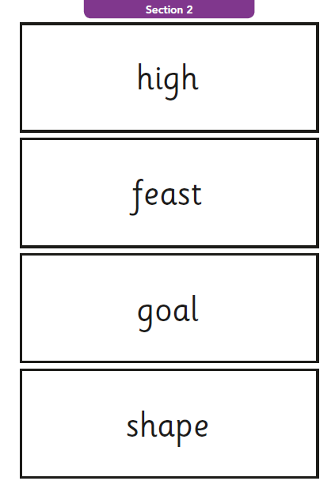
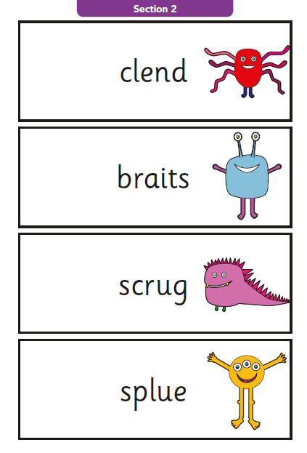
Example from 2017 paper

Slide 11
How can you help?
Read at home with your children
Read regularly – little and often
Encourage them to decode unknown words by breaking them into phonemes and identifying special friends (not letter names)
Write ‘alien’ words for them to read – create a game
Ensure they know all of the Set 1,2 and 3 sounds (by June!)
Familiarise the children with the test paper
Work through the paper in small chunks at home, prompting children to use their skills as above.

Slide 12
Read Write Inc. Book Bag Books and challenge books
Assessed and designed to be at your child’s level
Linked to class/guided reading books
Designed to develop independent reading
Additional comprehension activities
Book bag books change day - Thursday
Additional challenge books to share - Monday

Slide 13
More than just phonics
Word recognition and comprehension
Listen to your children read regularly
Read to your children
Make up stories and adventures/life experiences

Slide 14
Parent packs
List of Set 1, 2 and 3 sounds
Set 2 and 3 rhymes
Sound chart
Red words
Presentation on website
Sample paper link

Slide 15
Questions?

