Slide 1

Welcome to…

Slide 2
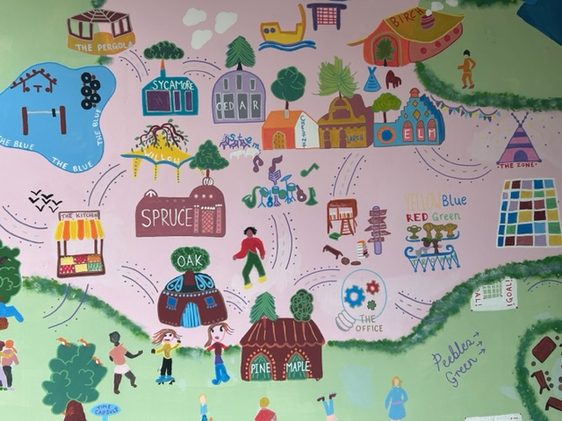

Slide 3

All about your child
1.Tell us what your child enjoys doing by writing it on a post-it (make sure you include their name and leave on your chair)
2.Think about what you want for your child when they start school and write it on a post-it (make sure you include their name and leave on your chair)

Slide 4
Transition to School
Each child is different, and some children may take a little longer to settle
Our transition processes are based on the best interests and needs of your child
We will work with you to help your child to settle and be confident in their new surroundings
Opportunities to ask questions and share concerns
Reception Transition Process:
Tuesday 11th July 11.15 Taster lunch for Reception children
Thursday 13th July Stay and play session(Children dropped by adults and left if child is confident in Reception) Cedar A 9.15-10.15 Cedar B 10.30-11.30
Tuesday 5th and Wednesday 6th September – 1:1 School visits(10-minute bookable slots)
Wednesday 6th September- Stay and Play session1.00pm – 1.45pm (Cedar A)
2.15pm – 3.00pm (Cedar B)
Thursday 7th September -Reception: 8.40-11.45(leave before lunch)
Friday 8th September Reception 8.40-1.00 (stay for lunch)
Monday 11th September: Reception 8.40-3.15 (normal hours)
Notes:
‘Transition: A process not an event’

Slide 5
How can I support my child to have a smooth start to school?
Before starting school you can support your child by encouraging them to:
Be independent including toileting and getting changed
Feel confident
Be happy to learn
Confident to make their voice heard
Try their best
Notes:
Being independent
-I am happy to be away from you as I know you are coming back.
-Give me opportunities to meet other children and adults and to spend time away from you.
-Help me develop and practice dressing, eating and going to the toilet so that I can care for myself.
Feeling good
-I can talk to you about how I feel and any worries I may have.
-I know how to keep myself safe and understand there are rules about what I can do.
-Make sure I have a healthy diet, lots of opportunities to play outside and be active, and time to sleep at night.
Loving learning
-I am interested in finding out about things that interest me.
-Provide me with opportunities to be creative; talk to me about my drawings.
-Take me to the library and look at books with me; point to pictures and name them clearly, and talk about what we can both see using simple phrases. Tell me stories too.
-Talk about what you are doing using a simple commentary; count out the number of apples put in the bag at the shop, and say what we see on the way.
Making my voice heard
-I can listen to others; help me practice taking turns and understand sharing.
-I can ask for help.
-Talk to me using words I can understand, and add words to help extend my vocabulary. This will help me to express what I want, so that others can understand me
-Let me sing songs and rhymes.
-Provide me with opportunities to meet other children and adults so that I can practice these skills.
Doing my best
-I am asking questions about my new school.
-Help me be the best I can be and have high hopes for me.
-Let me have plenty of opportunities to practice new skills, to make mistakes and try again.
-Be positive about going to school; talk to me about school, show me pictures of the school and visit the school. Talk to me about what I am going to do.

Slide 6

Areas of Learning
Within the Foundation Stage Curriculum there are seven areas of learning and three key characteristics of effective learning. The seven areas of learning are:
Prime Areas
Personal, Social and Emotional Development – Self regulation, managing self and building relationships
Physical Development – Gross motor and fine motor skills
Communication and Language – Listening and attention and understanding and Speaking
Specific Areas
4. Literacy – Comprehension, Word reading and writing
5. Mathematics – Number and numerical patterns
6. Understanding the World – Past and present, people, cultures and communities and the natural world
7. Expressive Arts and Design – Creating with materials and being imaginative and expressive

Slide 7
Daily Routine in Reception
Morning | Afternoon
8.40 Line up outside the classroom 8.45-8.55 Monday – Busy Fingers Tuesday- Busy Fingers Wednesday-Busy Fingers Thursday- Story from HT/ DHT Friday- Busy fingers (Parents welcome- Date to be confirmed once children have settled) 8.55-9.00 Class register 9.00- 9.15 English carpet input 9.15-9.30 English small group time (Monday- Thursday) 09.30-10.45 Child Initiated Learning (CIL) 10.45- 10.55 Tidy up time 10.55-11.10- Maths carpet input 11.10-11.40 Phonics RWI session 11.40-11.45- Wash hands and story/songs 11.45- 13.00 Lunch | 13.00- 13.05-Register 13.05-13.20 Carpet input (RE, PE, Music, PSHE, Computing, Understanding of the world, Expressive art and design and Forest school) 13.20- 14.40 Child Initiated Learning (CIL) 14.40 14.50 Tidy up time 14.50-15.00- Getting things ready for home time 15.00-15.15 Monday- Share travelling bears weekend and story Tuesday- Singing and whole class story Wednesday –Poem and whole class story Thursday –Singing and whole class story Friday - Poem and whole class story 15.15 Home time Once a week children will take part in a PE and Forest School session

Slide 8

Evidence Me Parent Share
At Eastbury Farm, we use ‘Evidence Me’ to keep you connected with your children’s learning. This enables you to receive observations of your child and show you next steps for your child’s learning. There is also the option for you to send in observations of your child’s learning at home. Children can answer questions on their observations at home to talk about their learning at school with their family.
Benefits to Parents
Regular access to your child’s learning journal
Positive conversations at home
A better understanding of the EYFS curriculum
Continuity of strategies at home e.g. behaviour, phonics or questioning
A positive learning experience for your child leading to better progress
Notes:
We strongly encourage parents to send in observations from home to help support the planning, teaching and assessment of your child.
Parents as partners.

Slide 9
How do we Assess?
Initial assessments
Statutory National Baseline assessment which is used within the first 6 weeks of children starting school. It will be an activity-based assessment of pupil's starting point in:
Language, Communication and Literacy and Mathematics. The assessment will be age- appropriate and last approximately 20 minutes.
Adult led activities
Exploratory play and investigation
Child initiated opportunities
Parental involvement – WOW moments via Evidence Me
Parents’ Evening – Autumn and Spring
End of year report - Summer term

Slide 10
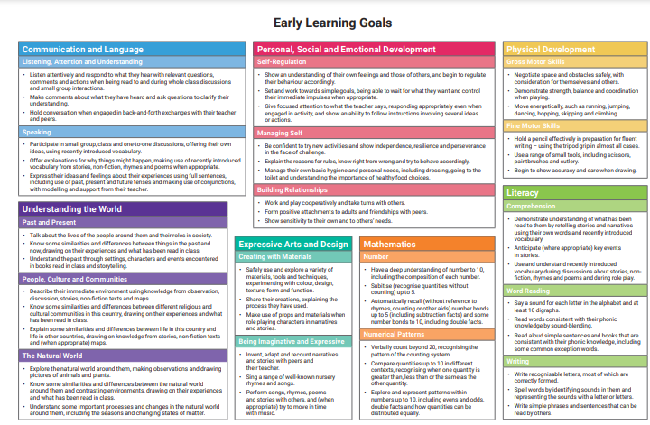
New Early Learning Goals 2021

Slide 11
Home School Link
Communication is so important. It plays a huge role in ensuring that you are regularly sharing information with us to best support your child.
We do this by…
Home link book
Reading records
Busy fingers- Parents welcome on Fridays
Evidence Me observations sent home
Daily chats at drop off and pick up time
Parent consultation meetings
Parent/Carer workshops (for example, how to support early reading)
Information and tips in newsletters and the school website

Slide 12

What to Bring to School
Suitable coat with a hood, as the children will be working outside as well as inside
Children are able to have milk free until their 5th birthday or can have water
Named, Transparent, re-usable plastic water bottle with a sports cap that can be closed easily
Waterproof clothing and wellington boots for Forest School in a named drawstring bag
PE bag – with black plimsolls, school PE T-shirt and green shorts (see uniform code)
Eastbury Farm Rucksack
Reception reading folder (once these have been given out including high frequency words (autumn term) and red words (spring term)
Reception children require a healthy packed lunch if your child is not having school meals (which are free in Reception, Year 1 and Year 2)
We are a Nut free school, so please don’t bring items in that contain nuts including spreads such as Nutella

Slide 13
Questions and Classroom tour
We will now be touring the Reception learning environments
If anyone has anything they would like to ask please feel free to ask us during the tour
If you have any questions personal to your family there will be an opportunity to ask these during the 1:1 school visit
Please also arrange your school visit appointment before you leave today. There will be an opportunity to do this on the class tour
Thank you for attending and we are really looking forward to welcoming your child to Eastbury Farm. We hope that it has been an informative and useful welcome meeting
Notes:
Remind parents that if something is worrying them now or when then child starts school/nursery it is important that they discuss their concerns with the class teacher.

